Slide 1


Welcome to Sesame Peanut Delights
Lamunu Elizabeth

Slide 2

Introduction
My Vision
Why? ReDi
Highlights of what i Learnt
Importance for my future
Sesame Peanut Delights Website

Slide 3
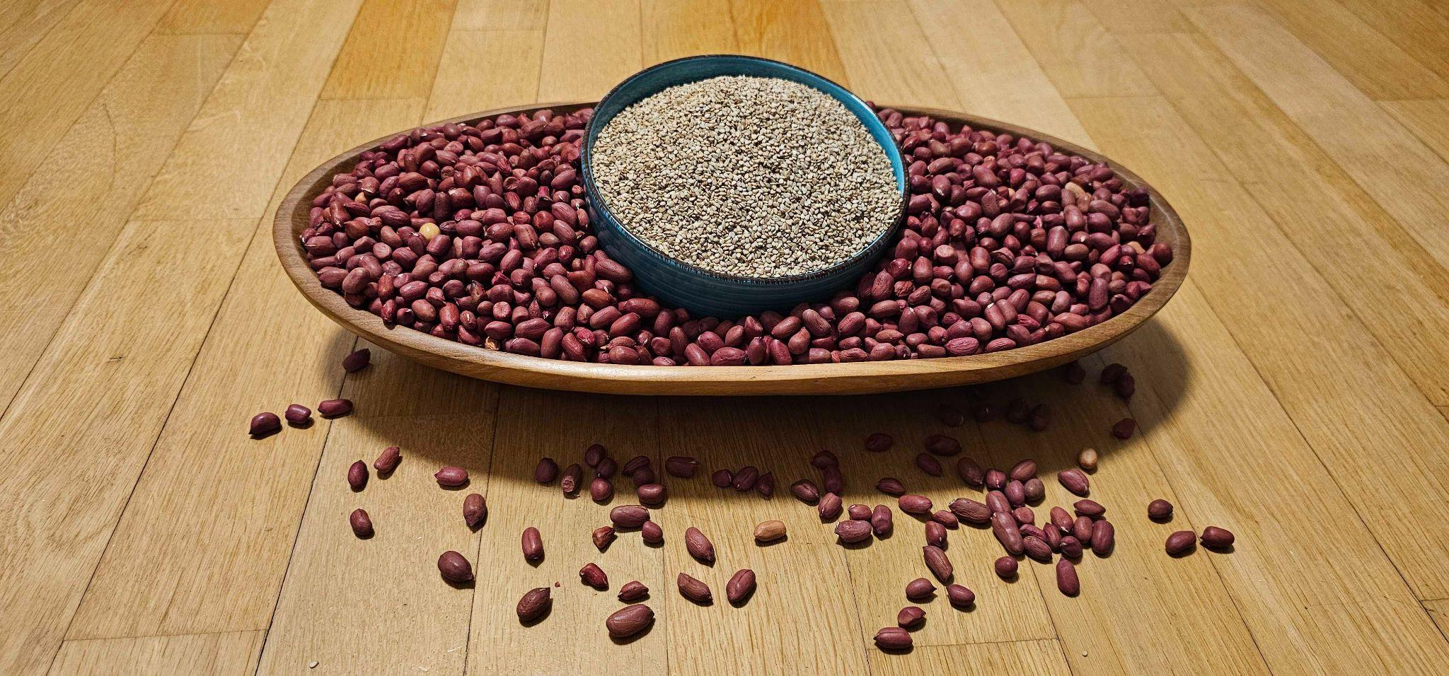
Sesame & Peanut
Uses
Benefits

Slide 4
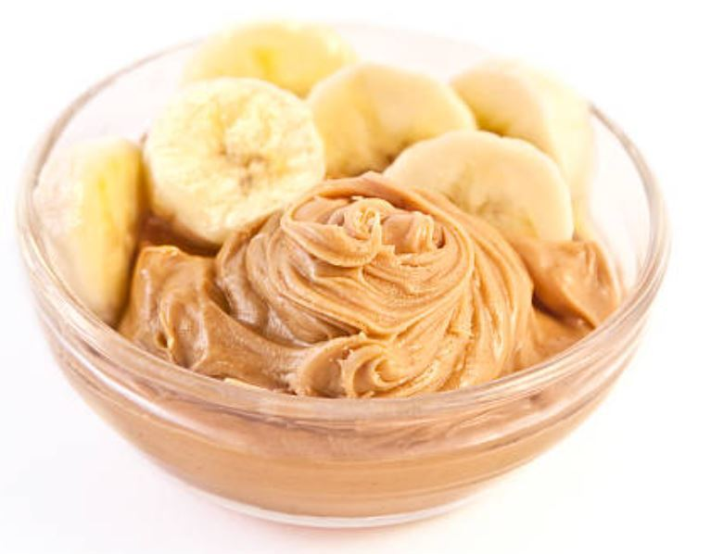
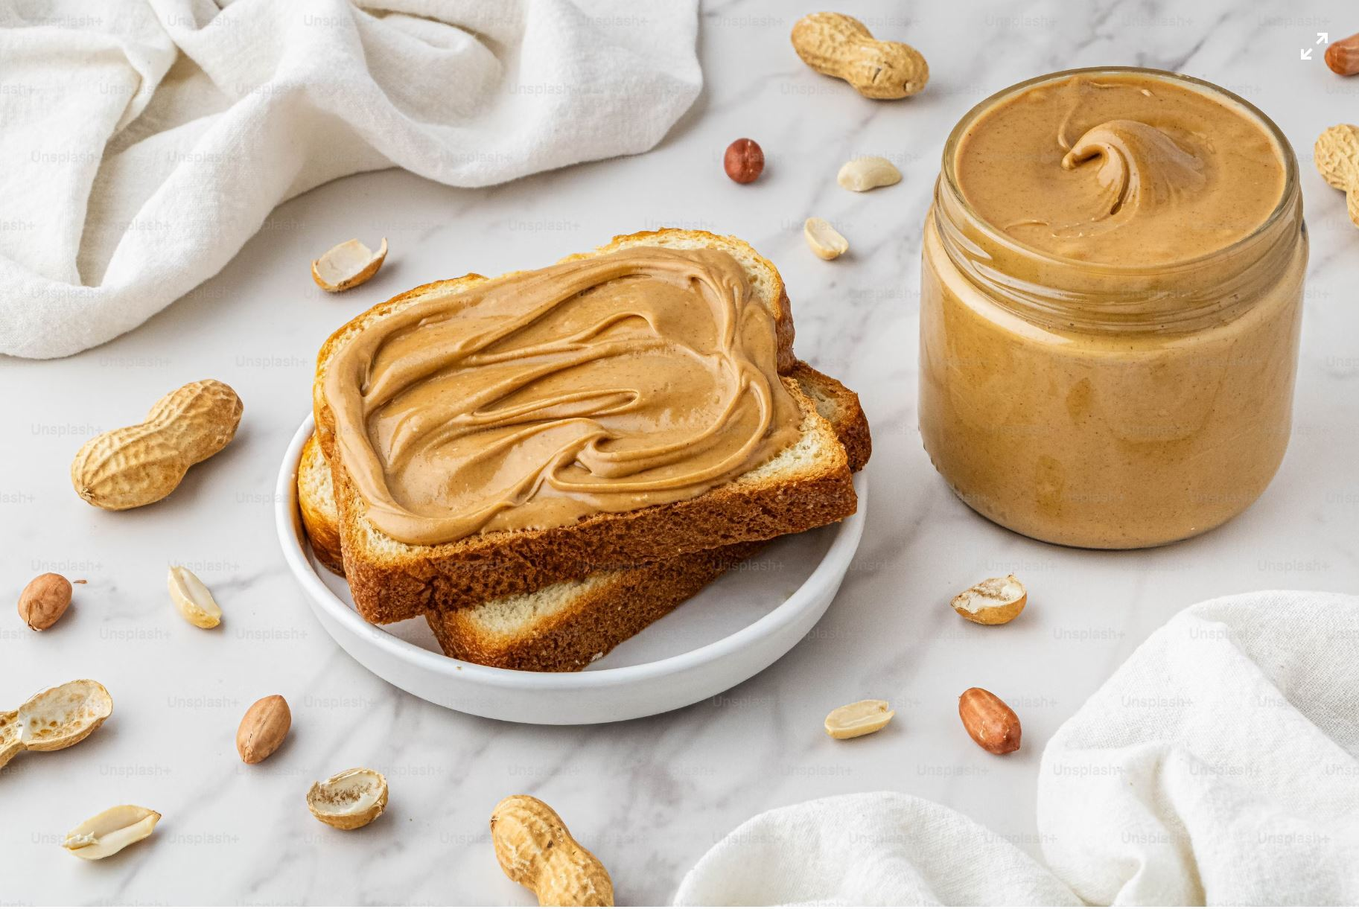
Products of Peanut & Sesame

Slide 5

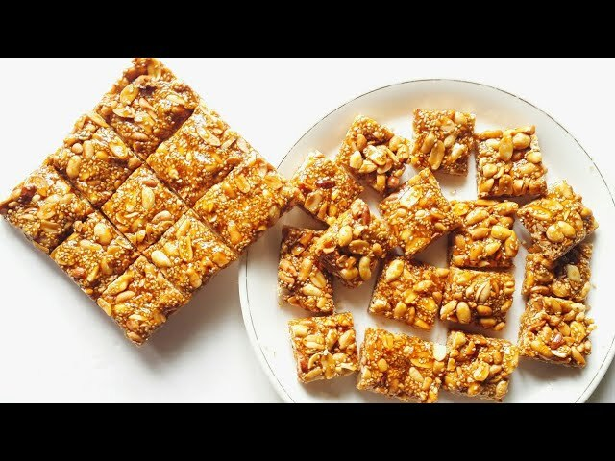
Products of Peanut & Sesame

Slide 6
Sesame Peanut Delights Website
To sell recipes
Increased visibility and Reach
Marketing
Branding
Customer Engagement and support

Slide 7
Thank you
The End

